Slide 1

DATABASE DESIGN & MANAGEMENT SI10317
PROGRAM STUDI SISTEM INFORMASI
UIVERRSITAS TARUMANAGARA

Slide 2
Course Schedule
1 REVIEW Entity Relationship Modeling dan Alternative ER Notation – Appendix C
2 Exercises
3. Enhanced Entity–Relationship Modeling
4. Exercises
5. REVIEW Normalization dan Exerises
6. Advanded Normalization dan Exercises
7. Database Analysis and the DreamHome Case Study
8. Presentasi Project UTS

Slide 3
Course Schedule
9. Methodology—Conceptual Database Design
10. Methodology—Logical Database Design
11. Exercises: Case Study Appendix A, B1, B2
12. Presentasi Project: Case Study
13. Query Processing
14. Distributed DBMSs—Concepts and Design
15. Replication and Mobile Databases
16. Presentasi Project UAS

Slide 4
Review
Entity Relationship Modeling

Slide 5
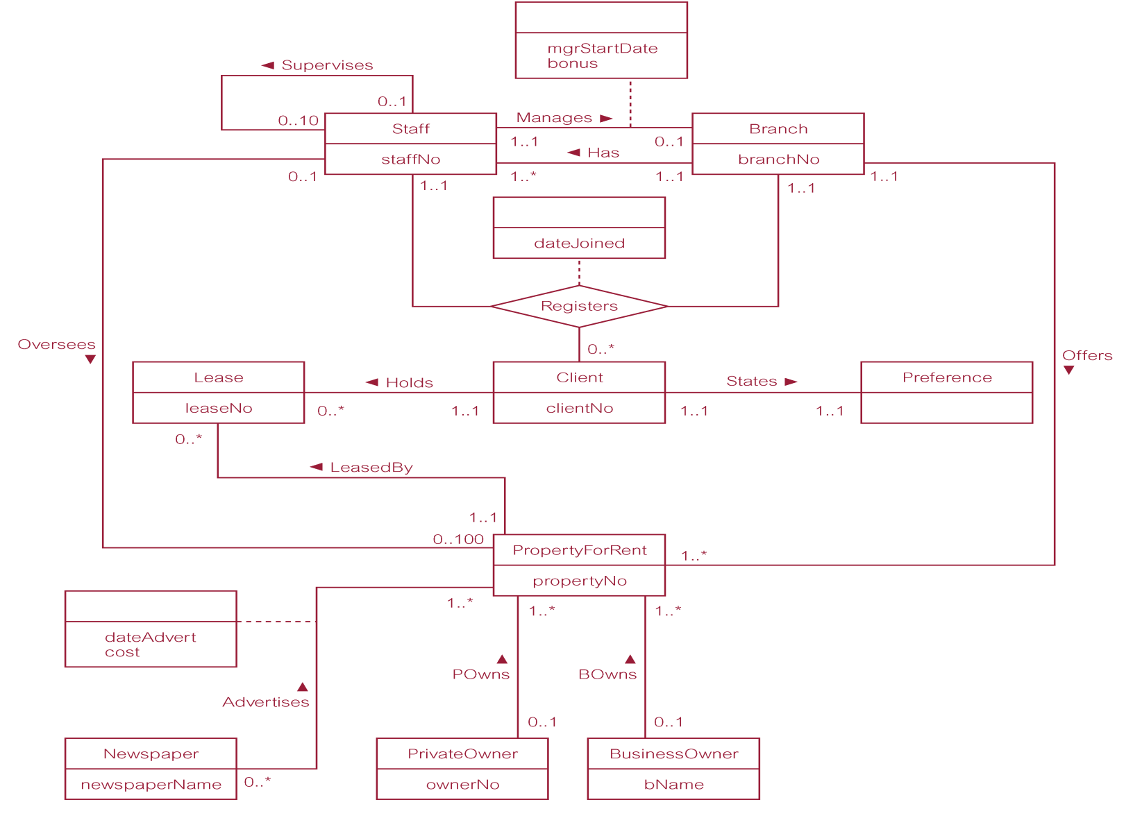
ER Diagram of Branch View of DreamHome

Slide 6
Entity Type
Entity type
Group of objects with same properties, identified by enterprise as having an independent existence.
Entity occurrence
Uniquely identifiable object of an entity type.

Slide 7
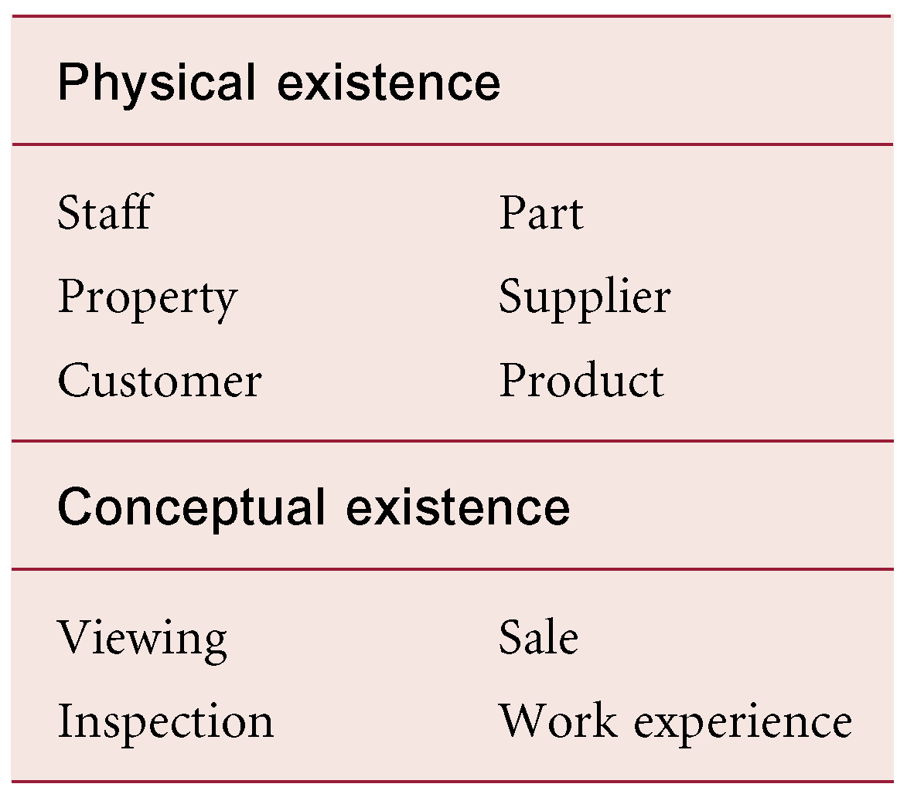
Examples of Entity Types

Slide 8
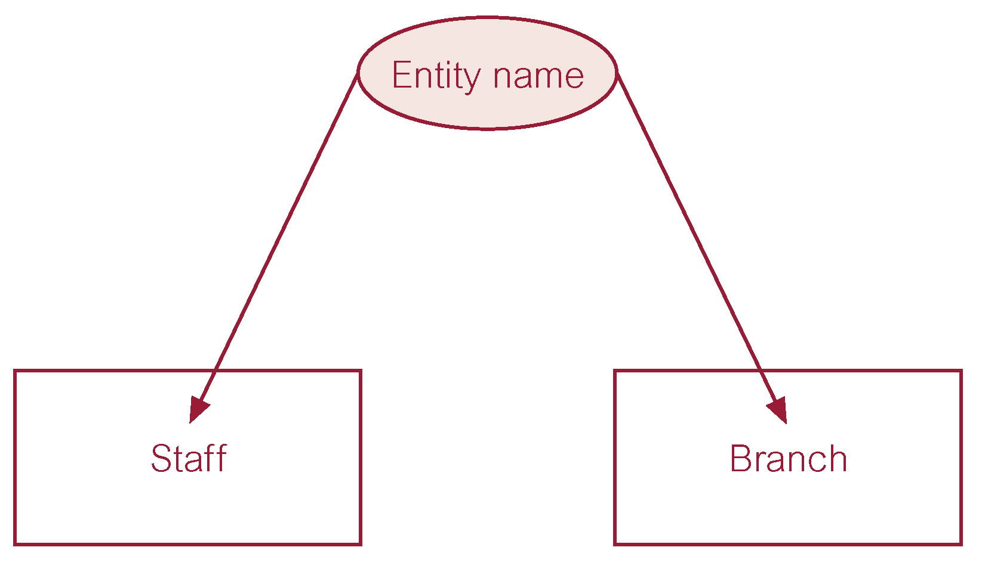
ER Diagram of Staff and Branch Entity Types

Slide 9
Relationship Types
Relationship type
Set of meaningful associations among entity types [Kumpulan asosiasi yang bermakna di antara jenis entitas]
Relationship occurrence
Uniquely identifiable association, which includes one occurrence from each participating entity type. [Asosiasi unik yang dapat diidentifikasi, yang mencakup satu kejadian dari setiap jenis entitas yang berpartisipasi]

Slide 10
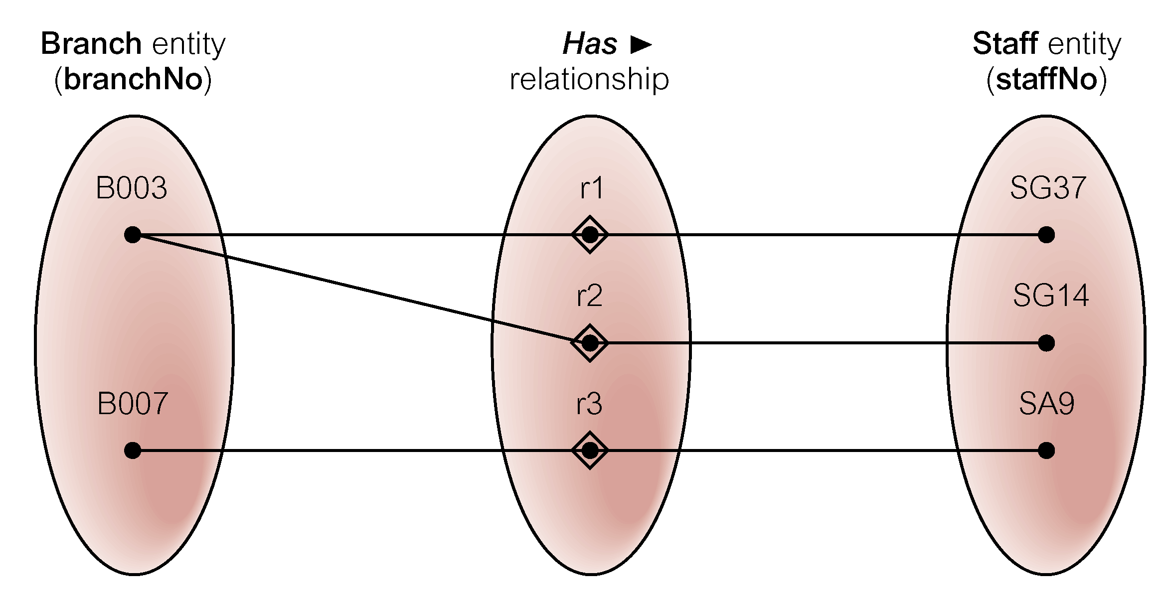
Semantic Net of Has Relationship Type

Slide 11
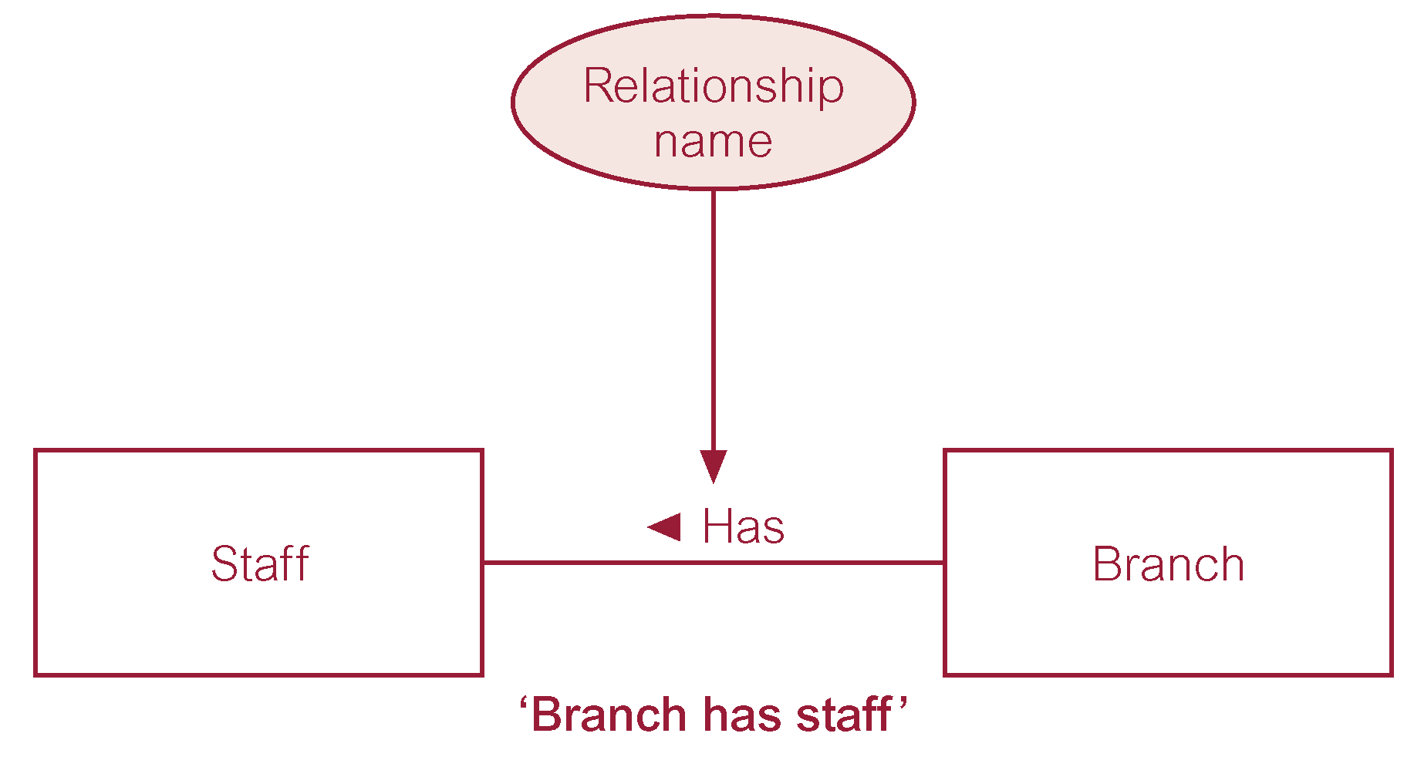
ER Diagram of Branch Has Staff Relationship

Slide 12
Relationship Types
Degree of a Relationship
Number of participating entities in relationship [Jumlah entitas yang berpartisipasi dalam hubungan]
Relationship of degree:
two is binary;
three is ternary;
four is quaternary [terdiri dari 4 bagian]

Slide 13
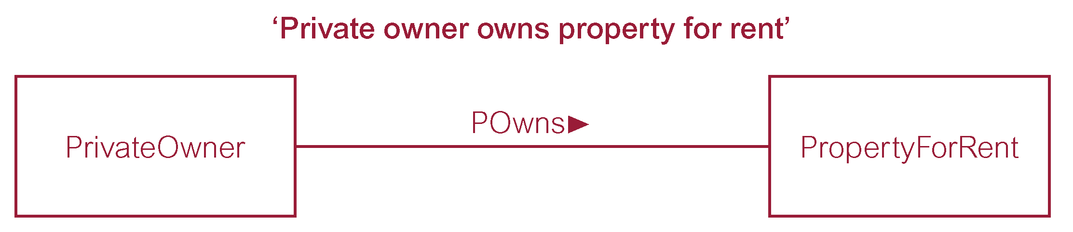
Binary Relationship called POwns

Slide 14
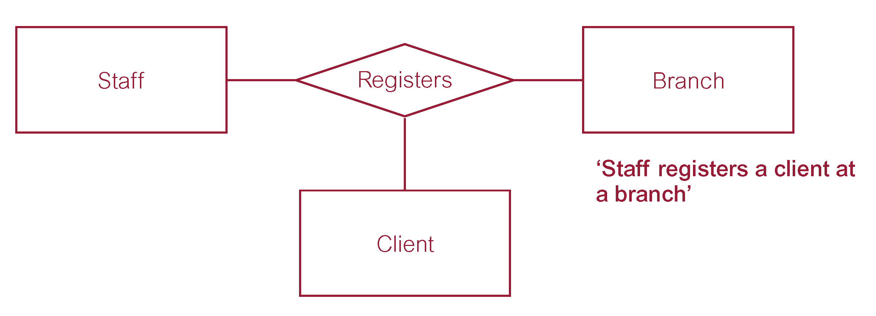
Ternary Relationship called Registers

Slide 15
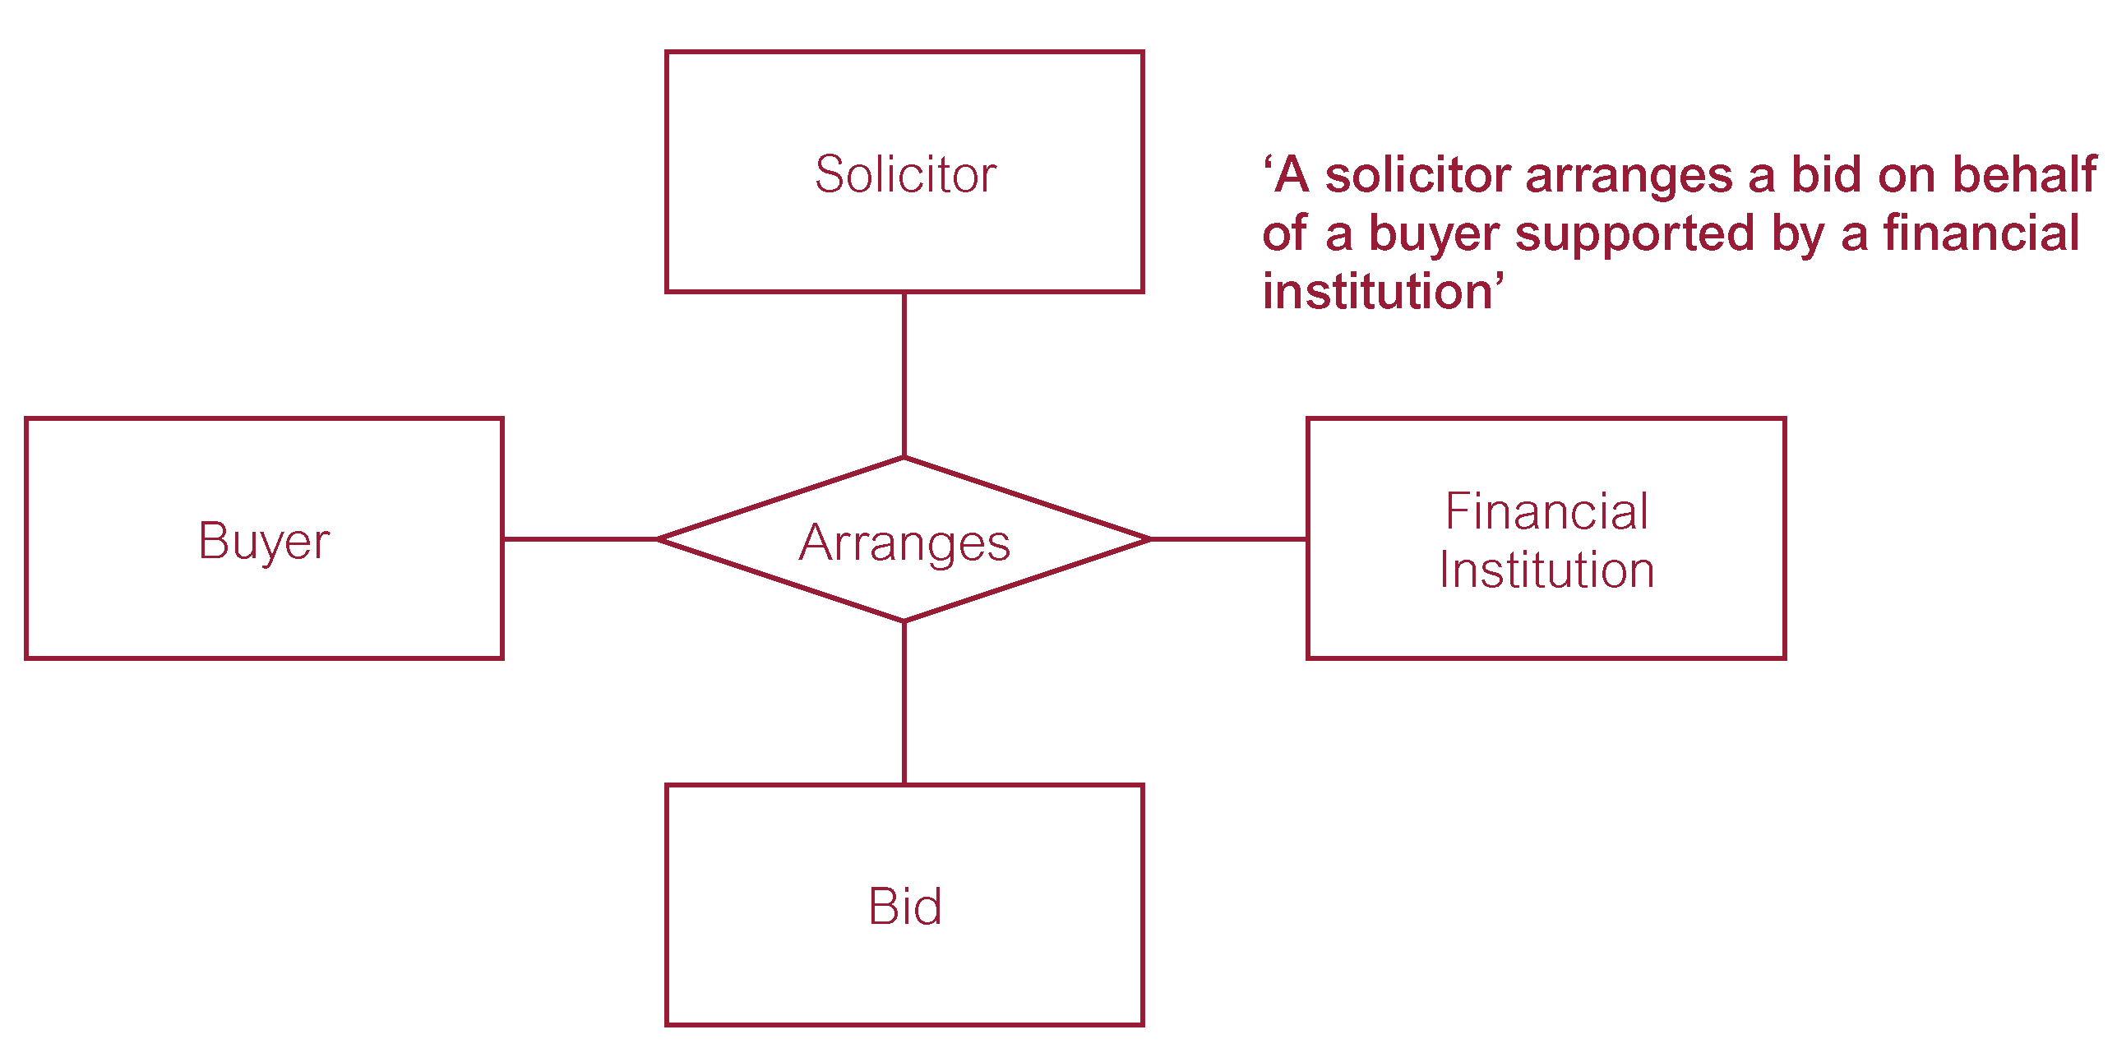
Quaternary Relationship called Arranges
pengacara mengatur tawaran atas nama pembeli yang didukung lembaga keuangan

Slide 16
Relationship Types
Recursive Relationship
Relationship type where same entity type participates more than once in different roles. [Jenis hubungan di mana jenis entitas yang sama berpartisipasi lebih dari sekali dalam peran yang berbeda.]
Relationships may be given role names to indicate purpose that each participating entity type plays in a relationship. [Hubungan dapat diberi nama peran untuk menunjukkan tujuan yang dimainkan oleh setiap jenis entitas yang berpartisipasi dalam suatu hubungan]

Slide 17
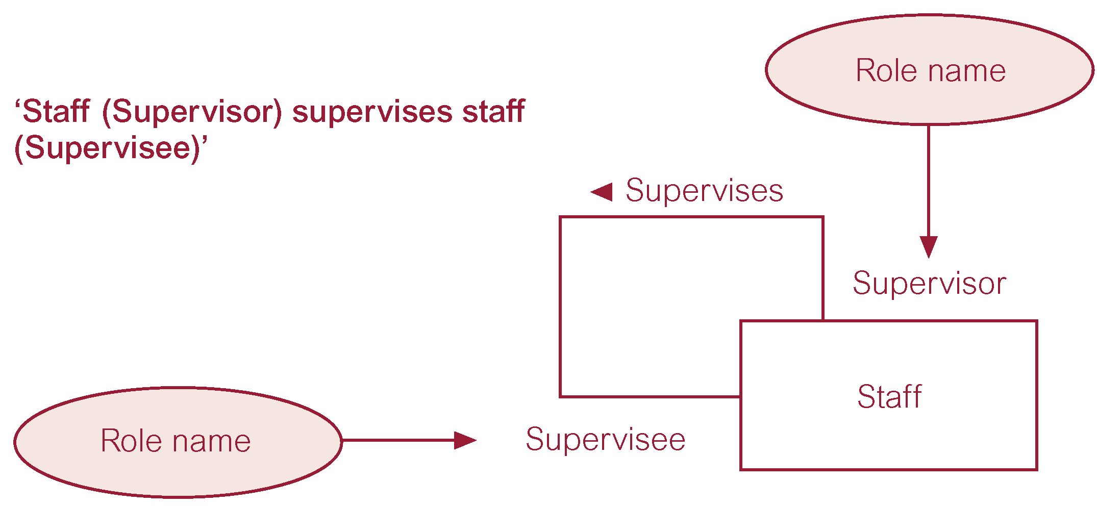
Recursive Relationship called Supervises with Role Names

Slide 18
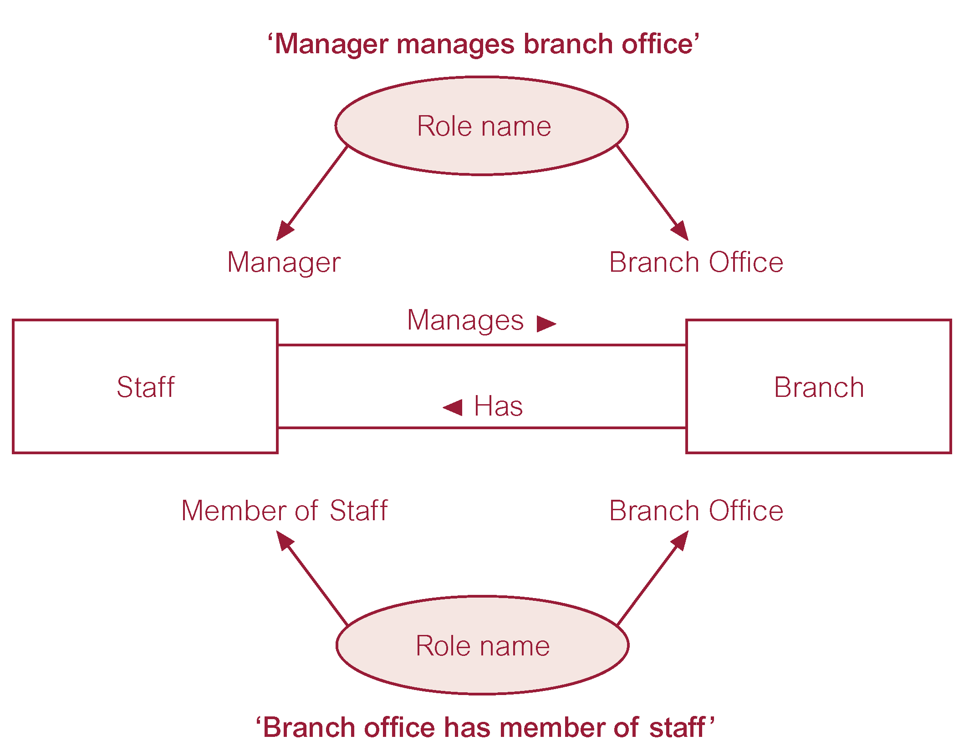
Entities associated through two distinct Relationships with Role Names

Slide 19
Attributes
Attribute
Property of an entity or a relationship type.
Attribute Domain
Set of allowable values for one or more attributes. [Kumpulan nilai yang diizinkan untuk satu atau lebih atribut]

Slide 20
Attributes
Simple Attribute
Attribute composed of a single component with an independent existence. [Atribut terdiri dari satu komponen dengan keberadaan independen]
Composite Attribute
Attribute composed of multiple components, each with an independent existence. [Atribut terdiri dari beberapa komponen, masing-masing dengan eksistensi independen]

Slide 21
Attributes
Single-valued Attribute
Attribute that holds a single value for each occurrence of an entity type. [Atribut yang menyimpan satu nilai untuk setiap kemunculan tipe entitas]
Multi-valued Attribute
Attribute that holds multiple values for each occurrence of an entity type. [Atribut yang menyimpan beberapa nilai untuk setiap kemunculan dari tipe entitas]

Slide 22
Attributes
Derived Attribute
Attribute that represents a value that is derivable from value of a related attribute, or set of attributes, not necessarily in the same entity type. [Atribut yang merepresentasikan nilai yang dapat diturunkan dari nilai atribut terkait, atau kumpulan atribut, tidak harus dalam tipe entitas yang sama]

Slide 23
Keys
Candidate Key
Minimal set of attributes that uniquely identifies each occurrence of an entity type.
Primary Key
Candidate key selected to uniquely identify each occurrence of an entity type.
Composite Key
A candidate key that consists of two or more attributes.

Slide 24
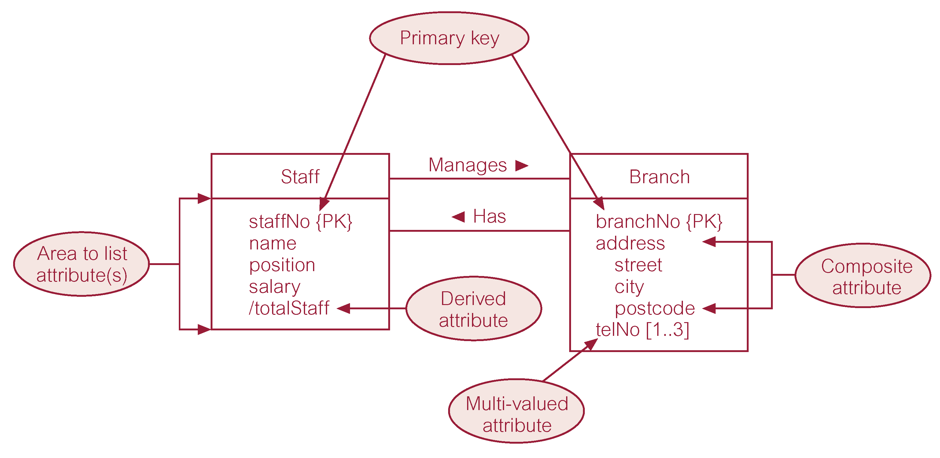
ER Diagram of Staff and Branch Entities and their Attributes

Slide 25
Entity Type
Strong Entity Type
Entity type that is not existence-dependent on some other entity type. [Jenis entitas yang tidak bergantung pada keberadaan beberapa jenis entitas lainnya]
Weak Entity Type
Entity type that is existence-dependent on some other entity type.

Slide 26
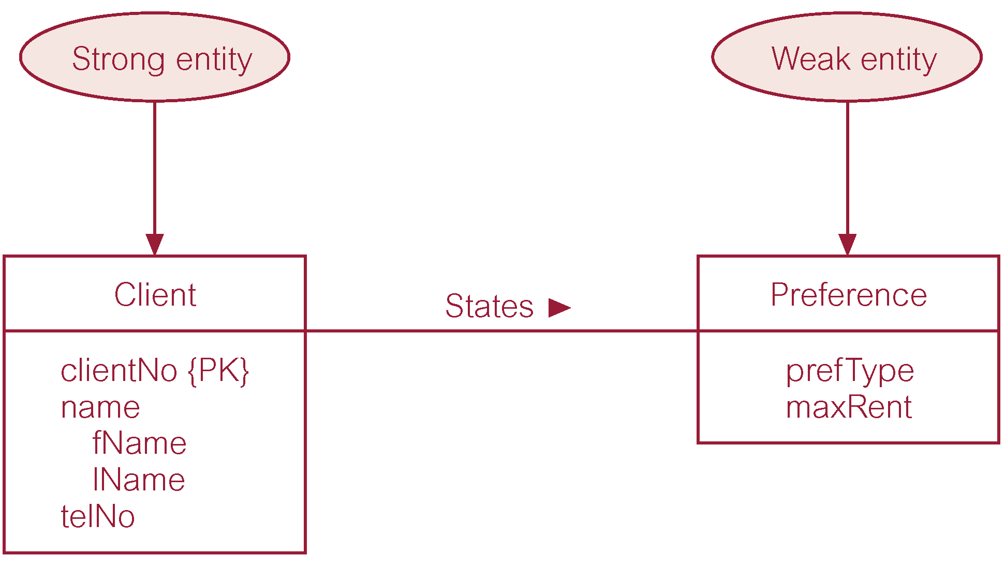
Strong Entity Type called Client and Weak Entity Type called Preference

Slide 27
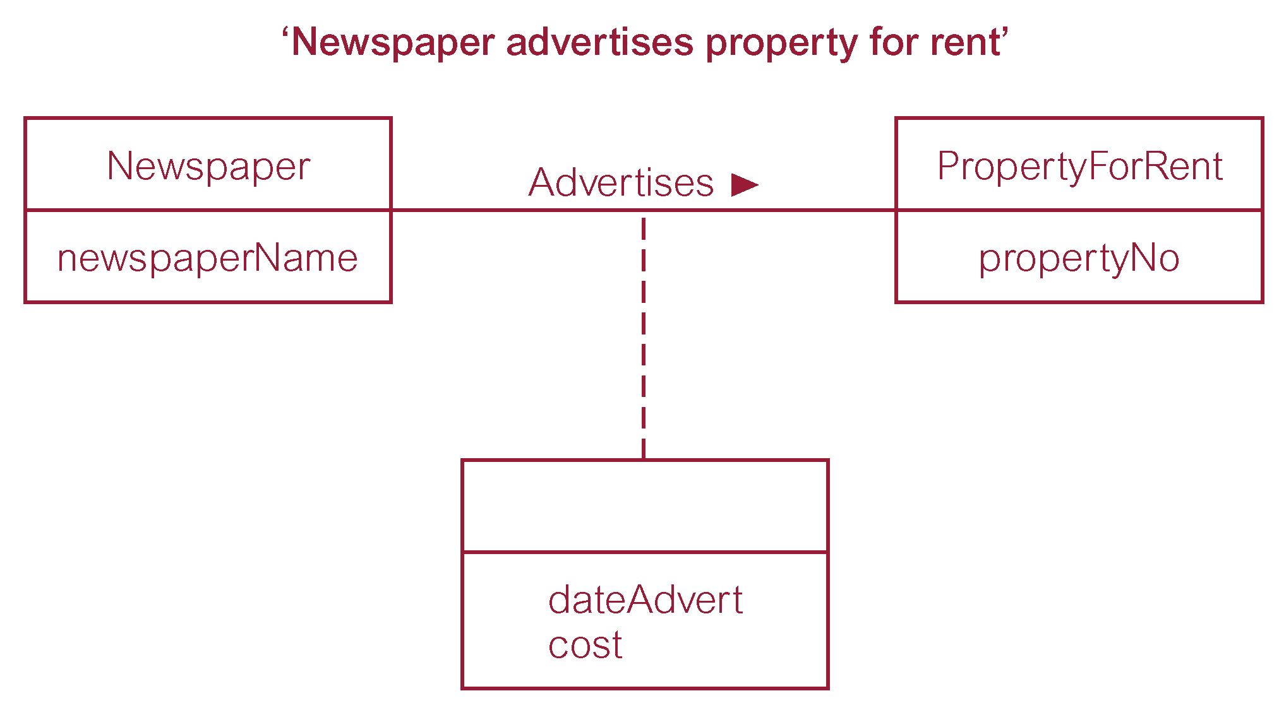
Relationship called Advertises with Attributes

Slide 28
Structural Constraints
Main type of constraint on relationships is called multiplicity. [Jenis batasan utama pada hubungan disebut multiplisitas]
Multiplicity - number (or range) of possible occurrences of an entity type that may relate to a single occurrence of an associated entity type through a particular relationship. [Multiplisitas - jumlah (atau rentang) kemungkinan kejadian dari tipe entitas yang mungkin berhubungan dengan kejadian tunggal dari tipe entitas terkait melalui hubungan tertentu]
Represents policies (called business rules) established by user or company. [Merupakan kebijakan (disebut aturan bisnis) yang dibuat oleh pengguna atau perusahaan]

Slide 29
Structural Constraints
The most common degree for relationships is binary. [Derajat paling umum untuk hubungan adalah biner]
Binary relationships are generally referred to as being:
one-to-one (1:1)
one-to-many (1:*)
many-to-many (*:*)

Slide 30
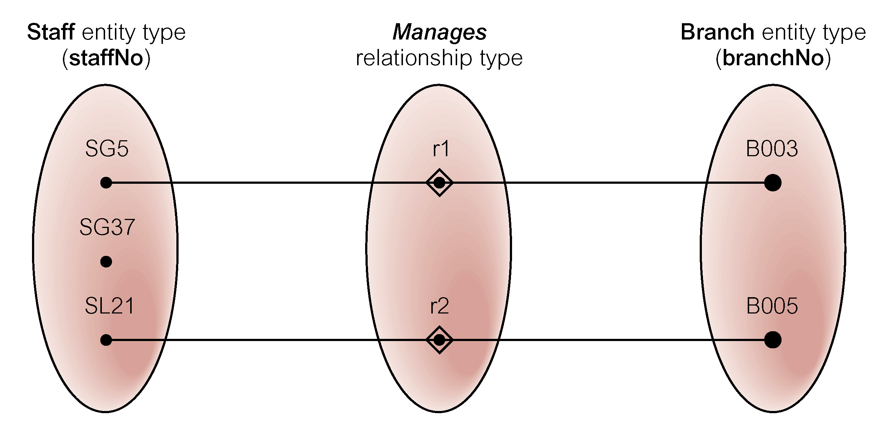
Semantic Net of Staff Manages Branch Relationship Type

Slide 31
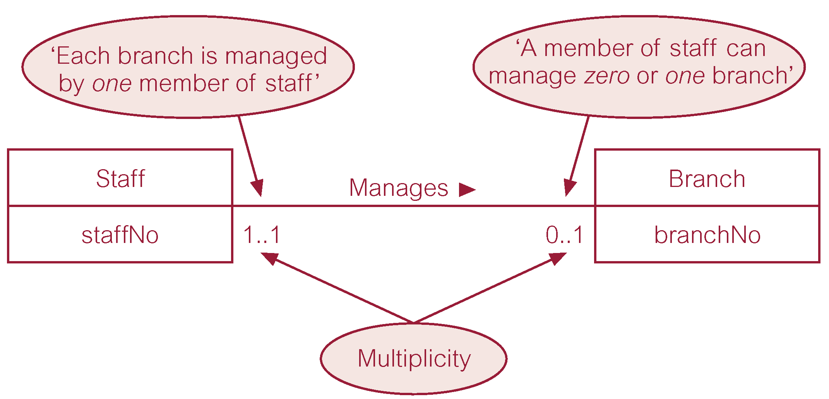
Multiplicity of Staff Manages Branch (1:1) Relationship Type
seorang anggota staf dapat mengelola nol atau satu cabang
setiap cabang dikelola oleh satu anggota staf

Slide 32
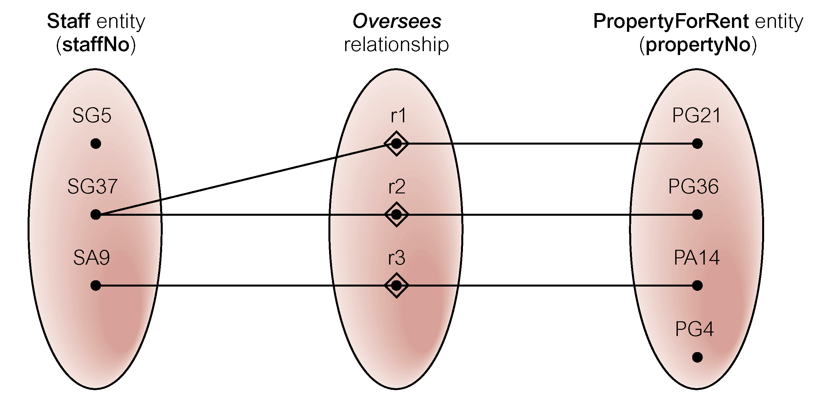
Semantic Net of Staff Oversees PropertyForRent Relationship Type

Slide 33
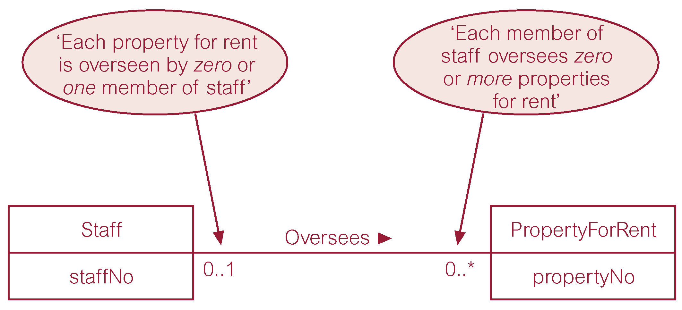
Multiplicity of Staff Oversees PropertyForRent (1:*) Relationship Type
setiap properti yang disewakan diawasi oleh nol atau satu staf

Slide 34
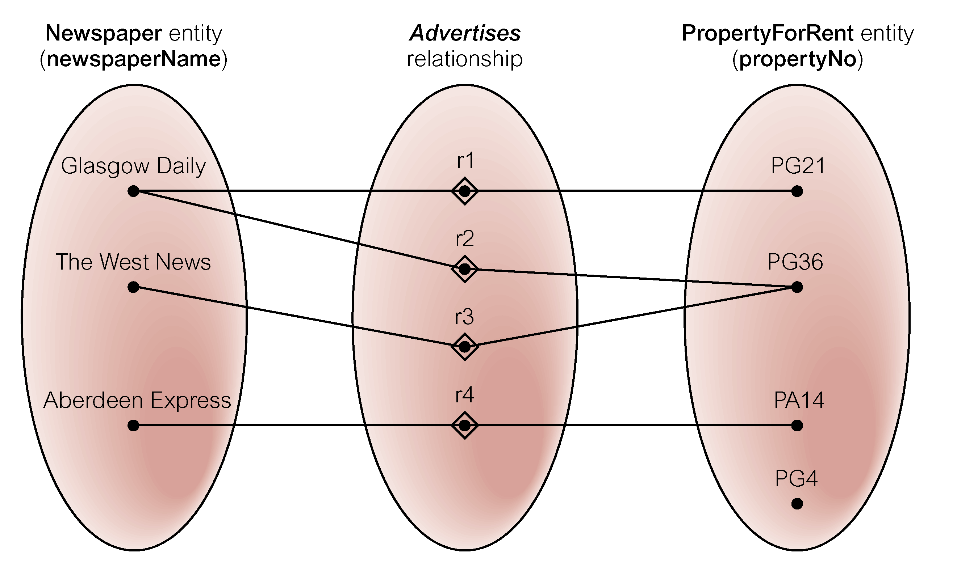
Semantic Net of Newspaper Advertises PropertyForRent Relationship Type

Slide 35
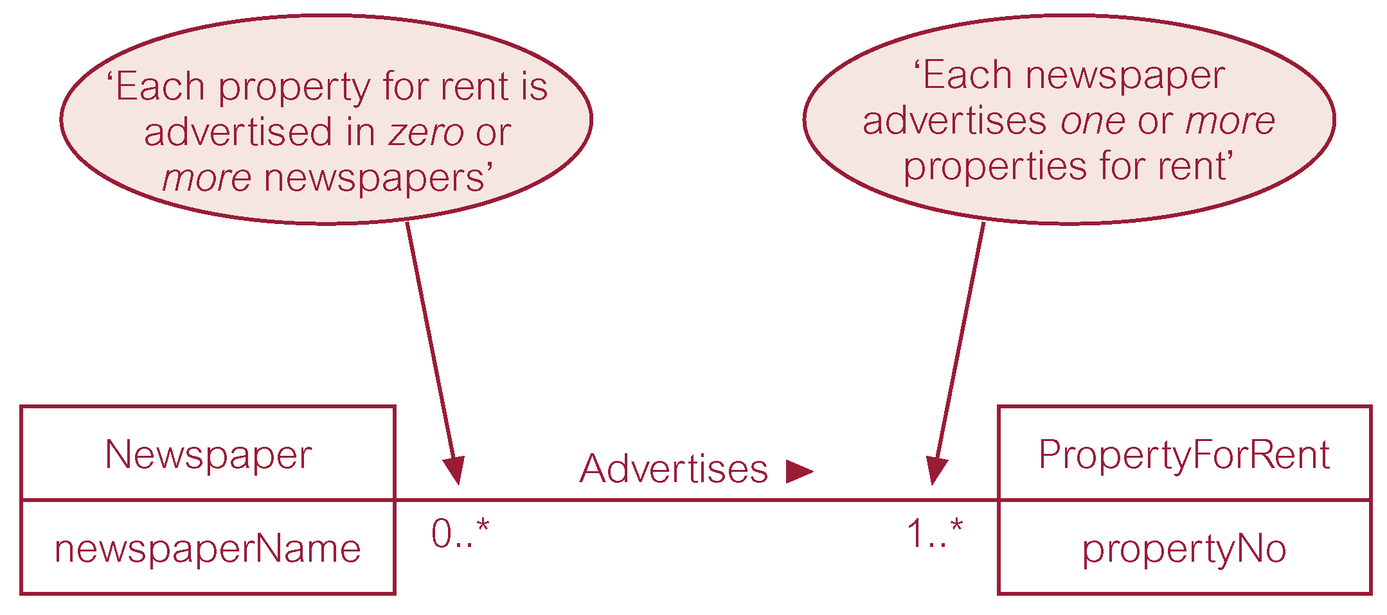
Multiplicity of Newspaper Advertises PropertyForRent (*:*) Relationship

Slide 36
Structural Constraints
Multiplicity for Complex Relationships
Number (or range) of possible occurrences of an entity type in an n-ary relationship when other (n-1) values are fixed. [Jumlah (atau rentang) kemungkinan kemunculan jenis entitas dalam hubungan n-ary ketika nilai (n-1) lainnya ditetapkan.]

Slide 37
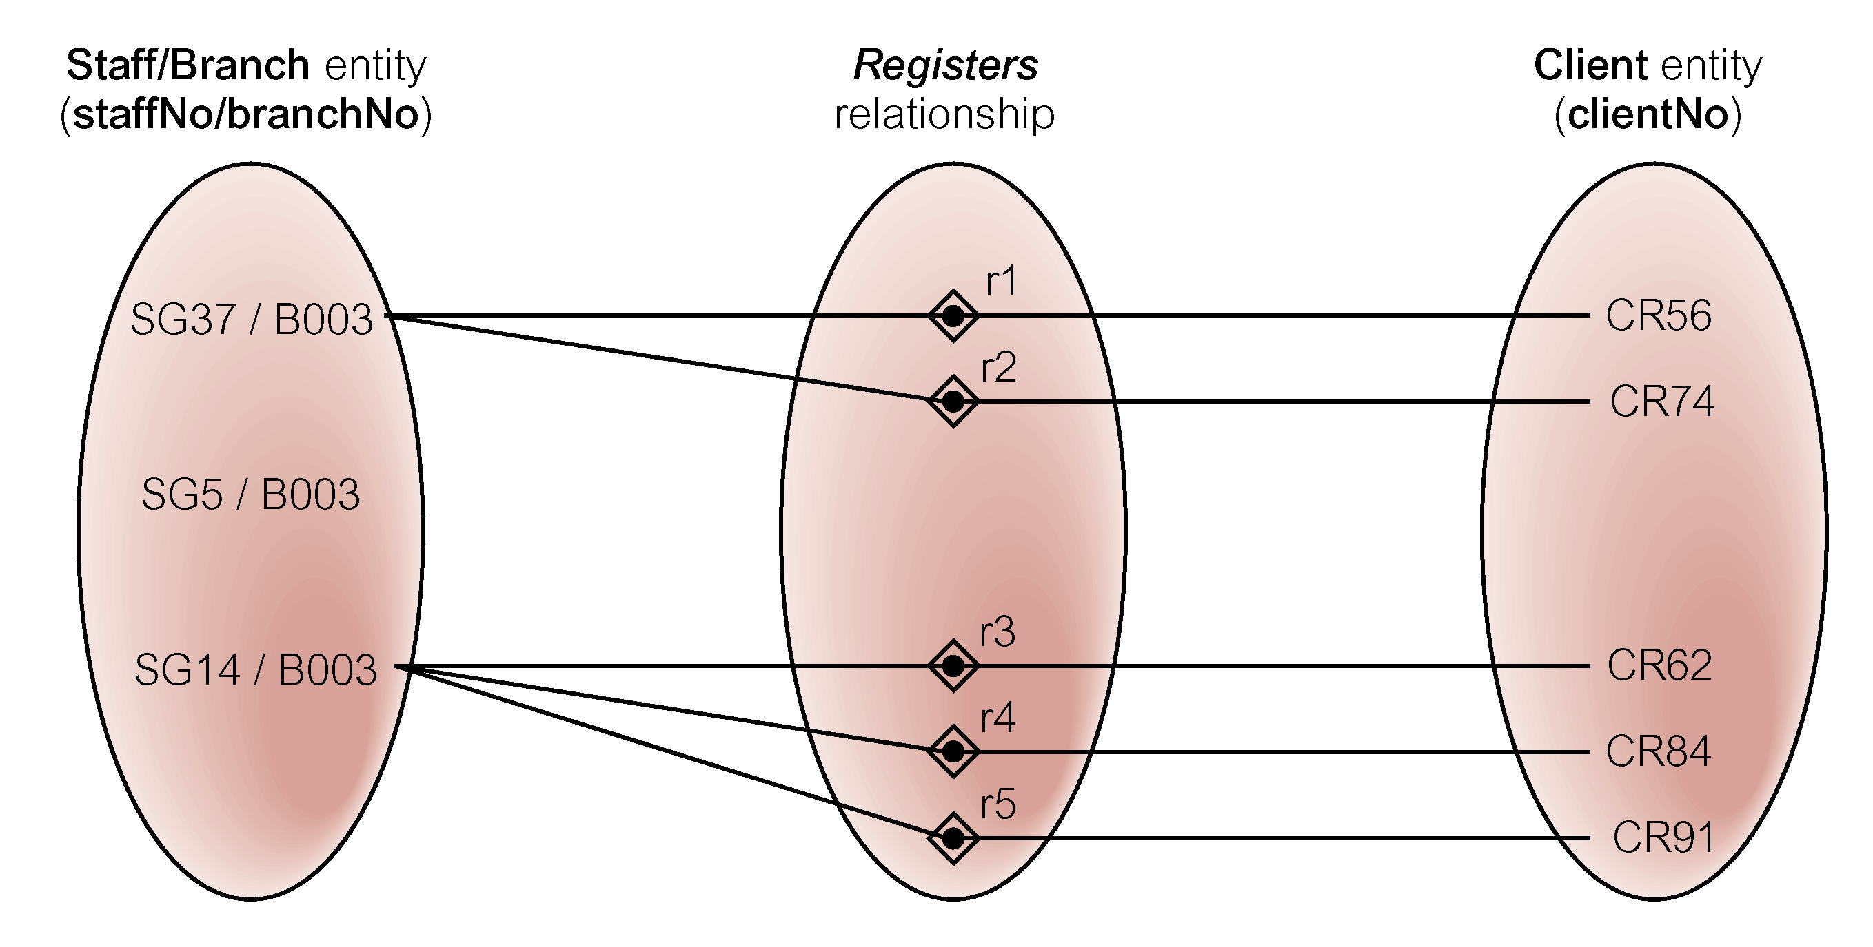
Semantic Net of Ternary Registers Relationship with Values for Staff and Branch Entities Fixed

Slide 38
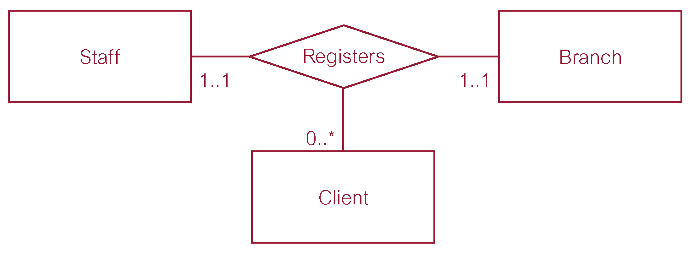
Multiplicity of Ternary Registers Relationship

Slide 39
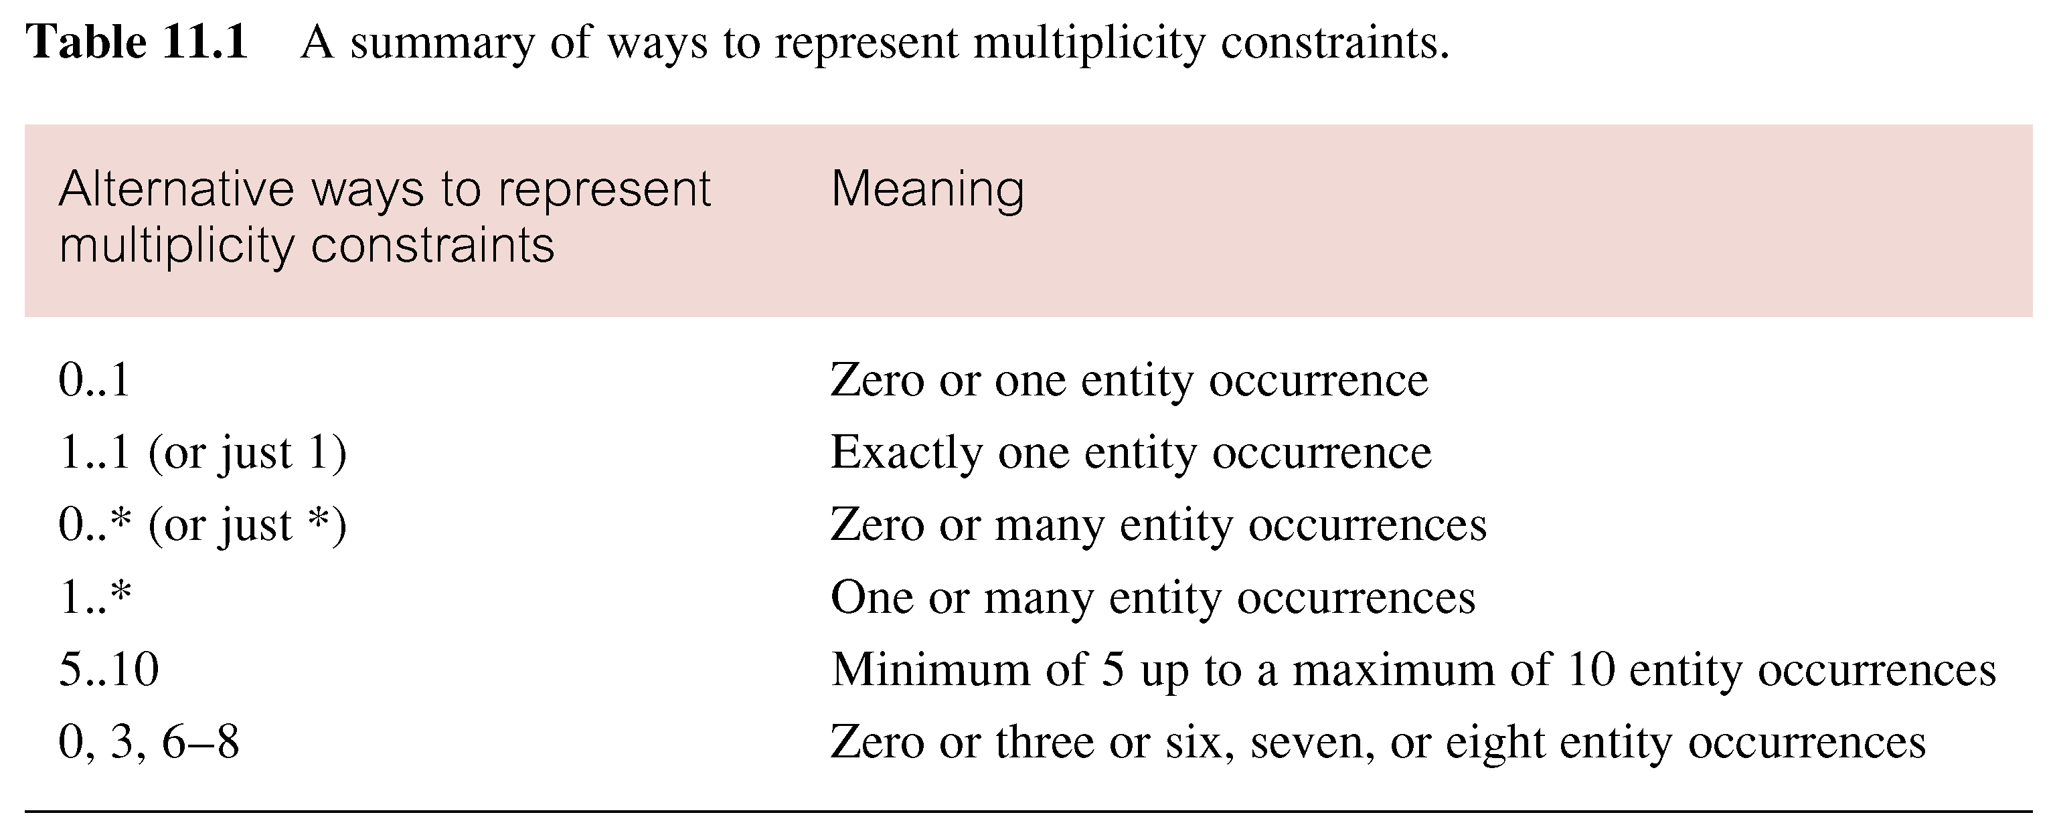
Summary of Multiplicity Constraints

Slide 40
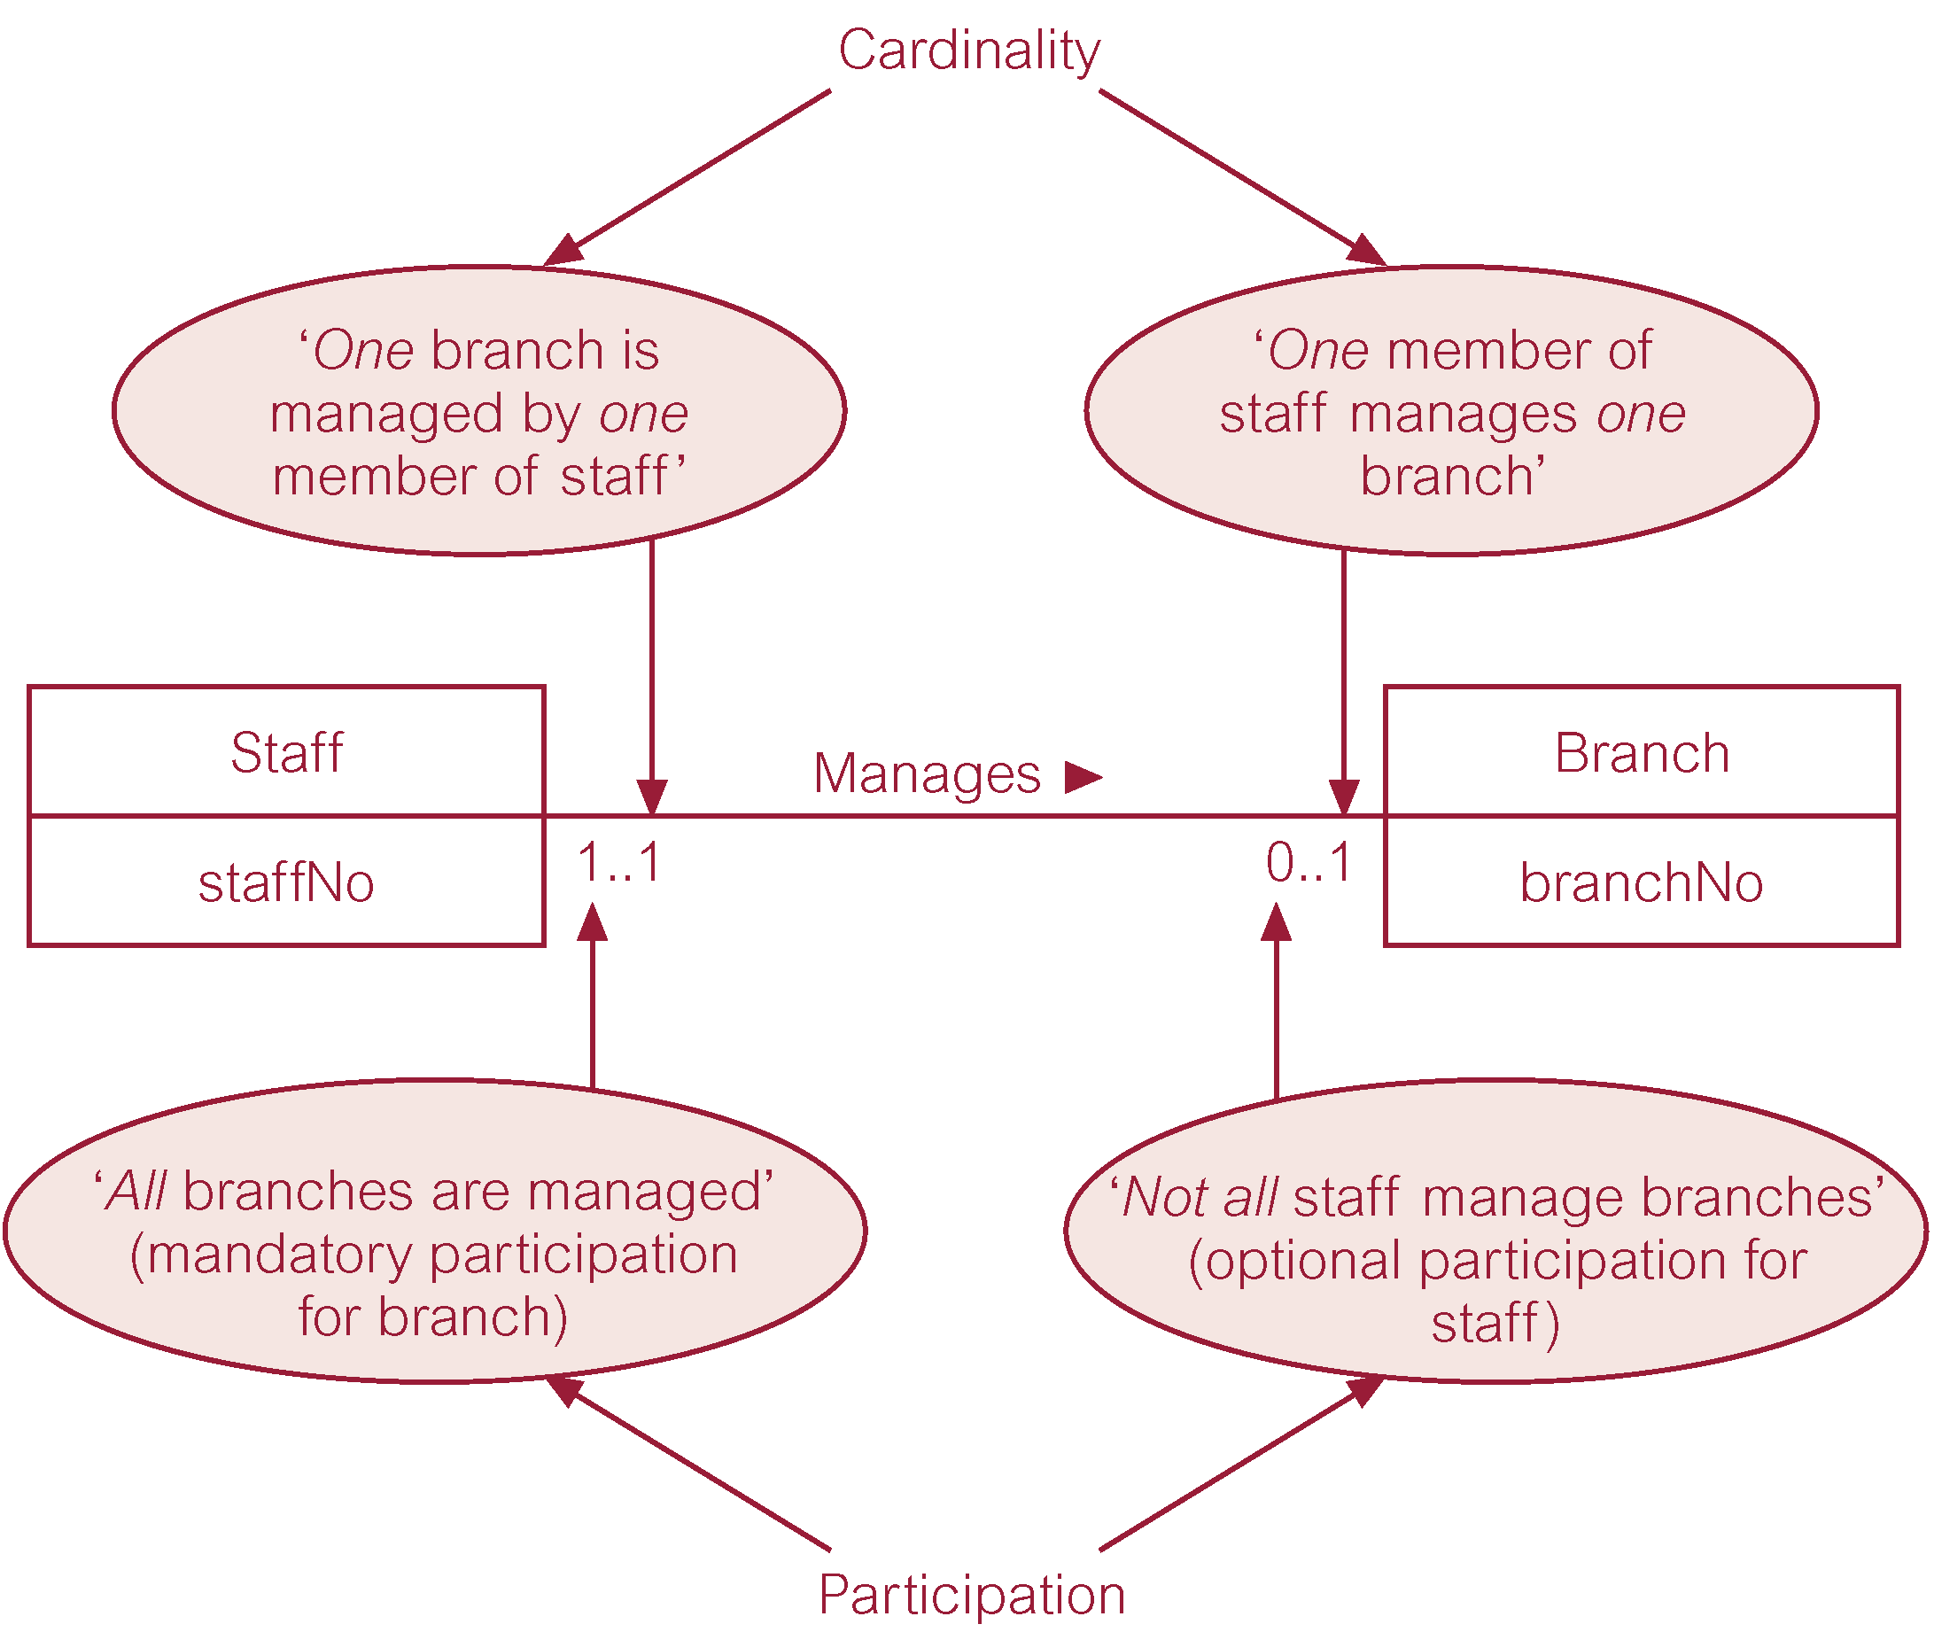
Multiplicity as Cardinality and Participation Constraints
Multiplisitas sebagai Kendala Kardinalitas dan Partisipasi
semua cabang dikelola (partisipasi wajib untuk cabang)

Slide 41
Problems with ER Models
Problems may arise when designing a conceptual data model called connection traps. [Masalah mungkin muncul saat merancang model data konseptual yang disebut jebakan koneksi]
Often due to a misinterpretation of the meaning of certain relationships. [Seringkali karena salah tafsir makna hubungan tertentu]
Two main types of connection traps are called fan traps and chasm traps. [Dua tipe utama jebakan penghubung disebut jebakan kipas dan jebakan jurang]

Slide 42
Problems with ER Models
Fan Trap
Where a model represents a relationship between entity types, but pathway between certain entity occurrences is ambiguous. [Dimana model merepresentasikan hubungan antara tipe entitas, tapi jalur antara kejadian entitas tertentu ambigu]
Chasm Trap
Where a model suggests the existence of a relationship between entity types, but pathway does not exist between certain entity occurrences. [Dimana model menyarankan adanya hubungan antara tipe entitas, tetapi jalur tidak ada antara kejadian entitas tertentu.]

Slide 43

An Example of a Fan Trap

Slide 44
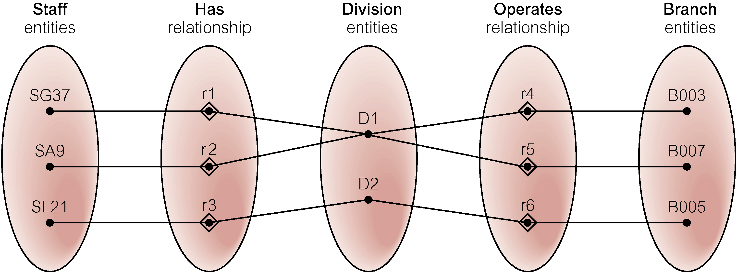
Semantic Net of ER Model with Fan Trap
At which branch office does staff number SG37 work?

Slide 45
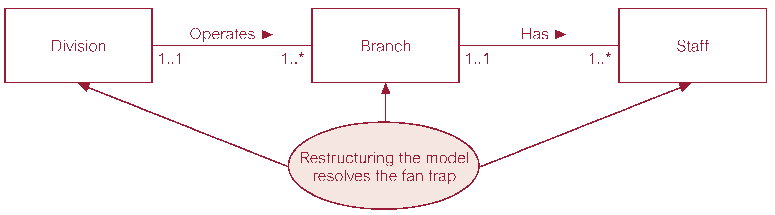
Restructuring ER Model to Remove Fan Trap

Slide 46
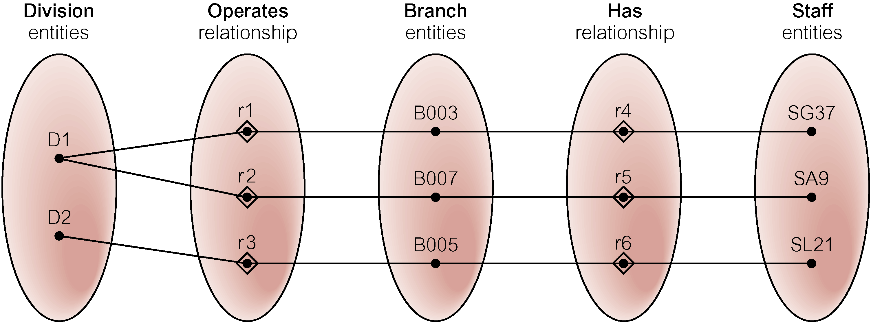
Semantic Net of Restructured ER Model with Fan Trap Removed
SG37 works at branch B003.

Slide 47

An Example of a Chasm Trap

Slide 48
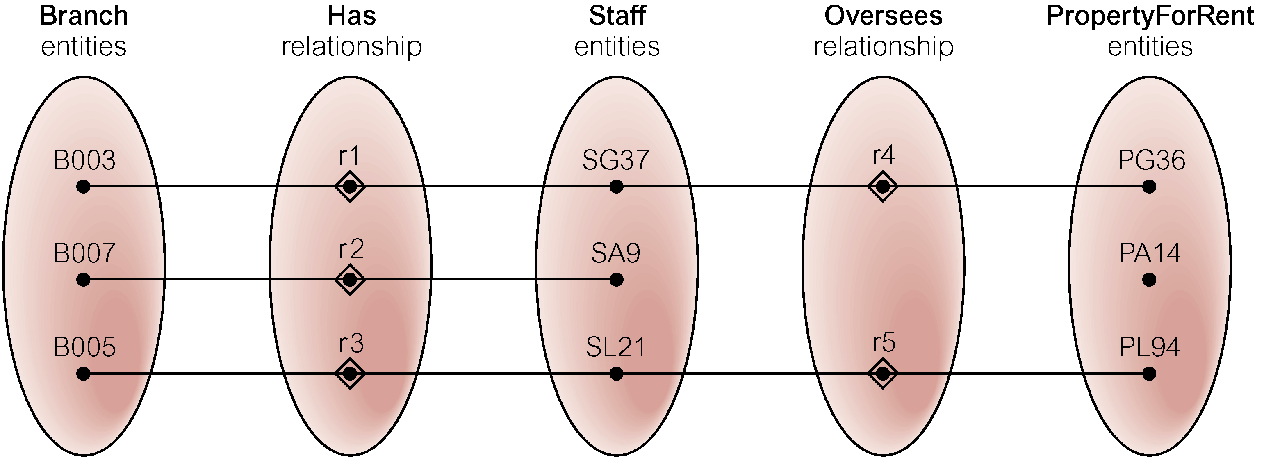
Semantic Net of ER Model with Chasm Trap
At which branch office is property PA14 available?

Slide 49
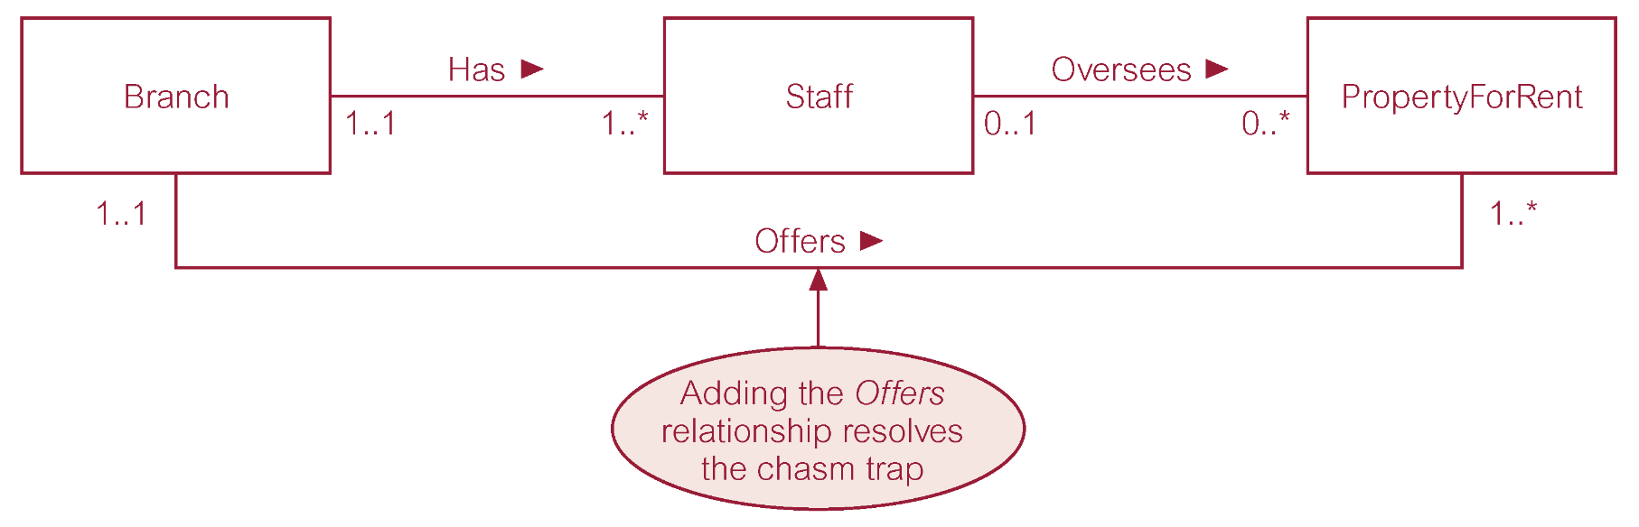
ER Model Restructured to Remove Chasm Trap

Slide 50
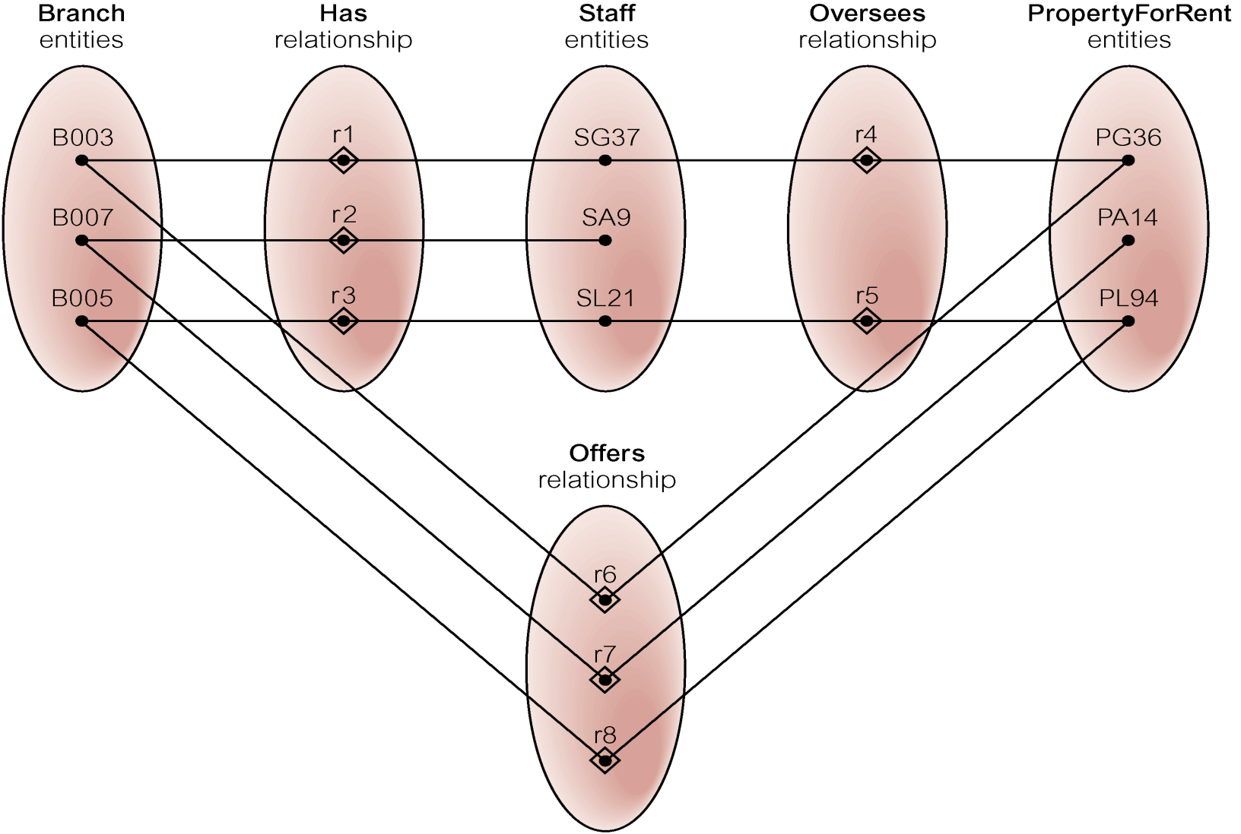
Semantic Net of Restructured ER Model with Chasm Trap Removed

Slide 51
Thank You
Reference: Database Systems A Practical Approach to Design, Implementation, and Management Fourth Edition.
Thomas M. Connolly and Carolyn E. Begg

